Slide 1

Linux Fundamentals VERSION 3 November-2022 Part 1 Eng Ali Mohammad. Bani Bakkar

Slide 2
Operating System
An operating system is a program on which application programs are executed and acts as an communication bridge (interface) between the user and the computer hardware.
The main task an operating system carries out is the allocation of resources and services, such as allocation of: memory, devices, processors and information. The operating system also includes programs to manage these resources, such as a traffic controller, a scheduler, memory management module, I/O programs, and a file system.

Slide 3
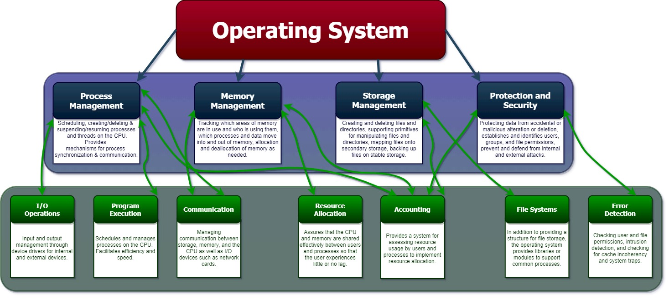

Slide 4
Operaring System Functions
Security
Control over system performance
Job accounting
Error detecting aids
Memory Management
Processor Management
Device Management
File Management
Notes:
Security – The operating system uses password protection to protect user data and similar other techniques. it also prevents unauthorized access to programs and user data.
Control over system performance – Monitors overall system health to help improve performance. records the response time between service requests and system response to have a complete view of the system health. This can help improve performance by providing important information needed to troubleshoot problems.
Job accounting – Operating system Keeps track of time and resources used by various tasks and users, this information can be used to track resource usage for a particular user or group of user.
Error detecting aids – Operating system constantly monitors the system to detect errors and avoid the malfunctioning of computer system.
Coordination between other software and users – Operating systems also coordinate and assign interpreters, compilers, assemblers and other software to the various users of the computer systems.
Memory Management – The operating system manages the Primary Memory or Main Memory. Main memory is made up of a large array of bytes or words where each byte or word is assigned a certain address. Main memory is a fast storage and it can be accessed directly by the CPU. For a program to be executed, it should be first loaded in the main memory. An Operating System performs the following activities for memory management:It keeps tracks of primary memory, i.e., which bytes of memory are used by which user program. The memory addresses that have already been allocated and the memory addresses of the memory that has not yet been used. In multi programming, the OS decides the order in which process are granted access to memory, and for how long. It Allocates the memory to a process when the process requests it and deallocates the memory when the process has terminated or is performing an I/O operation.
Processor Management – In a multi programming environment, the OS decides the order in which processes have access to the processor, and how much processing time each process has. This function of OS is called process scheduling. An Operating System performs the following activities for processor management.Keeps tracks of the status of processes. The program which perform this task is known as traffic controller. Allocates the CPU that is processor to a process. De-allocates processor when a process is no more required.
Device Management – An OS manages device communication via their respective drivers. It performs the following activities for device management. Keeps tracks of all devices connected to system. designates a program responsible for every device known as the Input/Output controller. Decides which process gets access to a certain device and for how long. Allocates devices in an effective and efficient way. Deallocates devices when they are no longer required.
File Management – A file system is organized into directories for efficient or easy navigation and usage. These directories may contain other directories and other files. An Operating System carries out the following file management activities. It keeps track of where information is stored, user access settings and status of every file and more… These facilities are collectively known as the file system.

Slide 5
Manages the CPU processing time and priority
Processing Applications
multitasking = ability of the operating system run multiple software programs (only one programs gets processed at a time)
multiprocessing = ability of the operating system to run multiple software programs at the same time
Number of users with simultaneous access
multiuser = ability of the operating system to allow multiple users access to the same computer at the same time
single user = the operating system only allows a single user at a time access to the computer
Multithreading

Slide 6
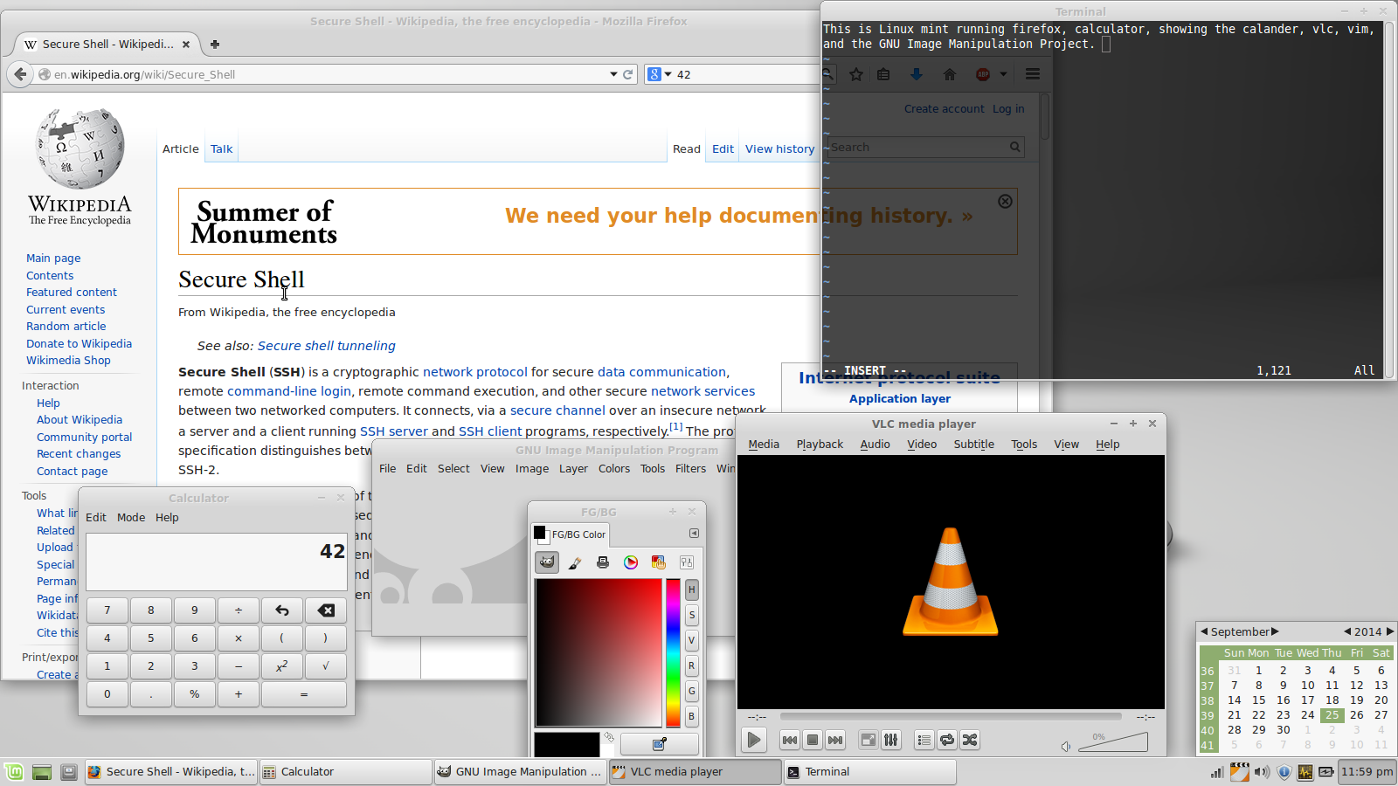
multitasking

Slide 7
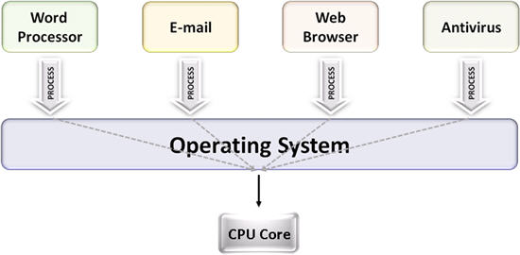
multitasking

Slide 8
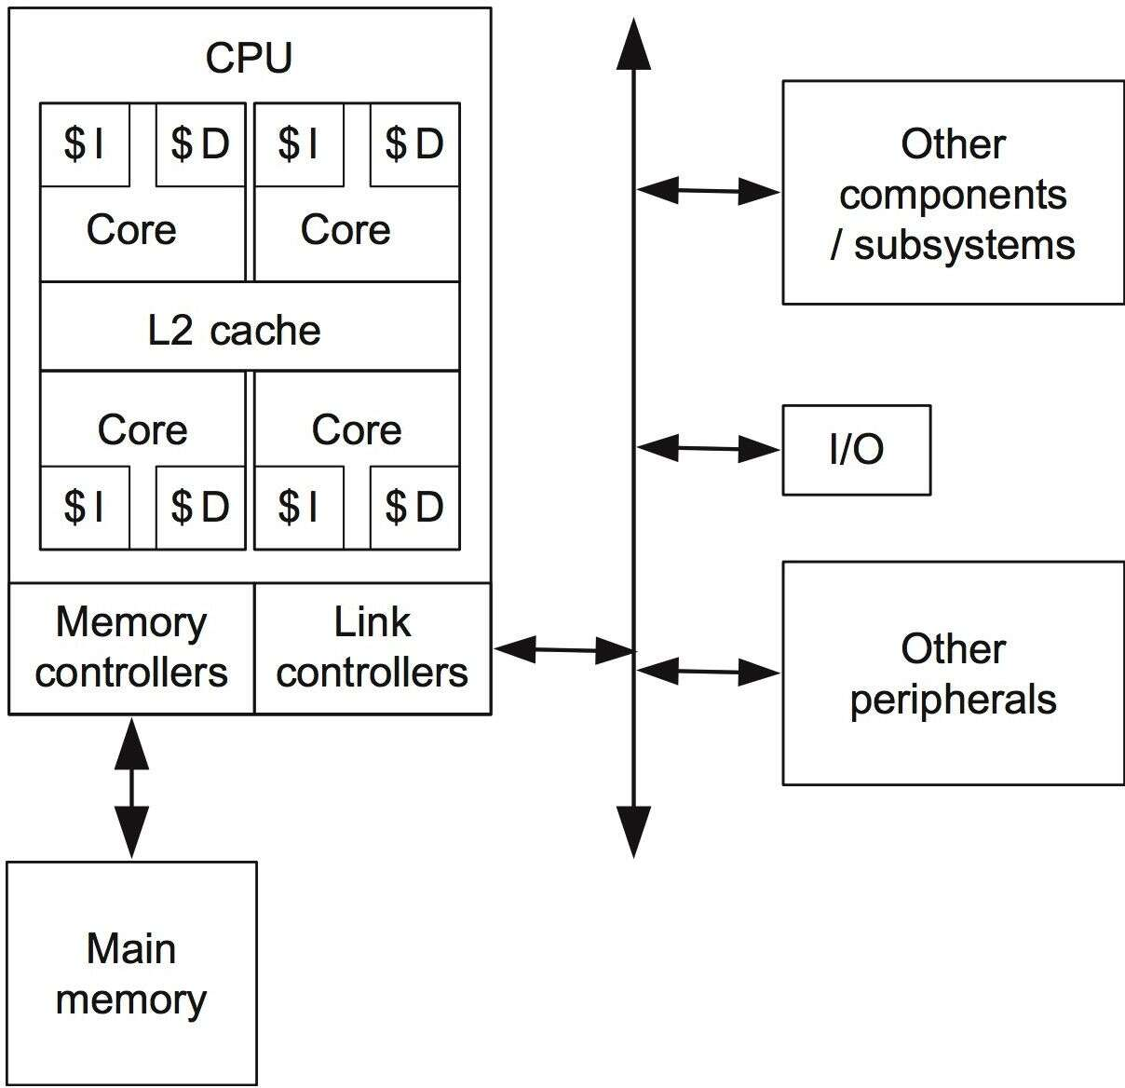
multiprocessing

Slide 9
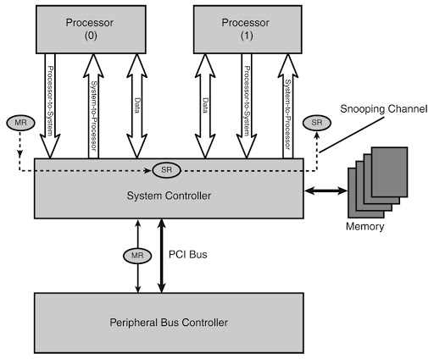
multiprocessing

Slide 10
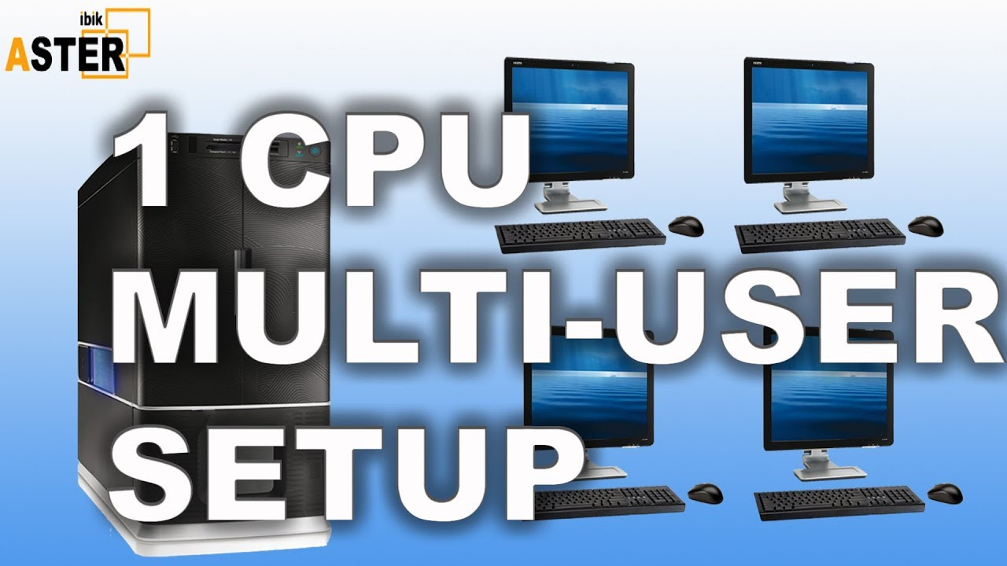
multiuser

Slide 11
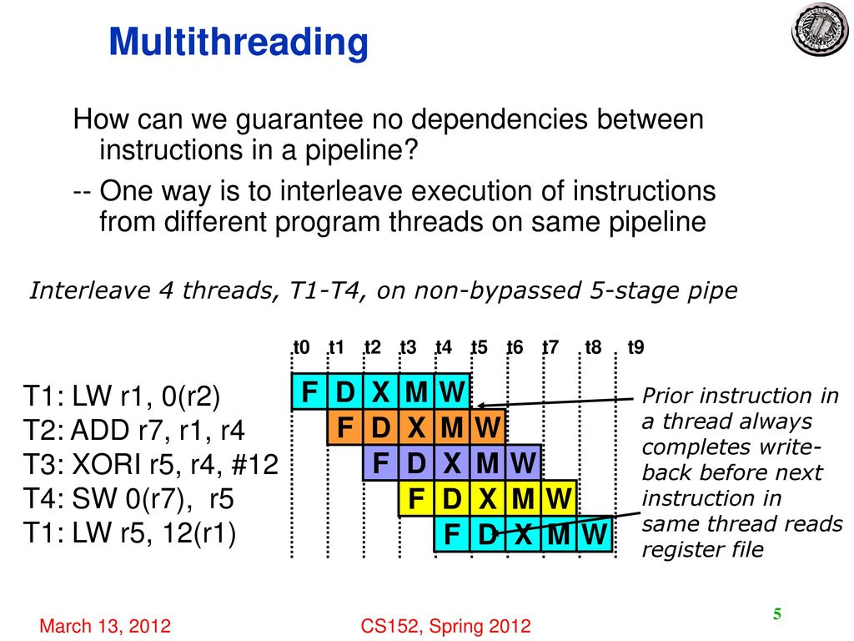

Slide 12
Manages and Interacts with Computer Hardware
Provides the interface for storage devices and manages how data is stored on those devices
- in charge of formatting disks
- creates sectors and clusters
- creates F.A.T. \
- sends message when disk is
full or there is some other
problem with writing data to
the disk
- virtual memory
- CD-ROM, DVD-ROM
- Flash drive
Provides the Interface for Input and Output Devices

Slide 13
Provides the System Interface
System Interface or shell = the interface between the computer
Command Line Interface (CLI)(sh, ksh, csh, tcsh, zsh, Bash, etc.)
Graphical User Interface (GUI)(KDE, GNOME, XFCE, LXDE and MATE.)

Slide 14
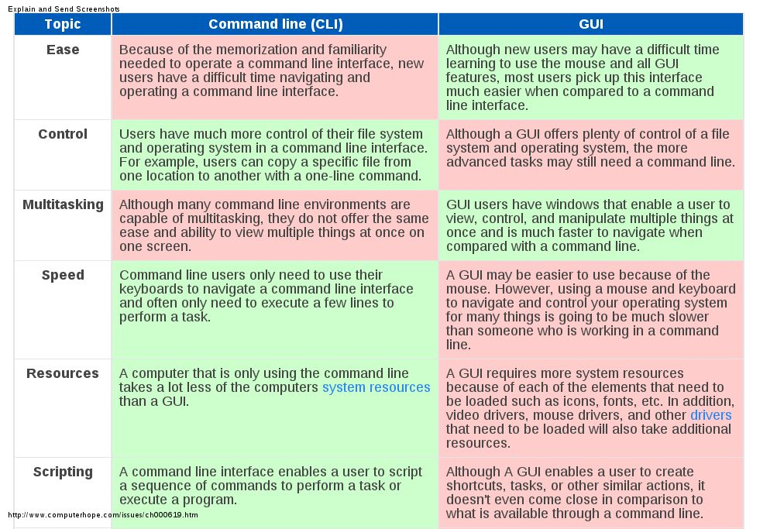

Slide 15
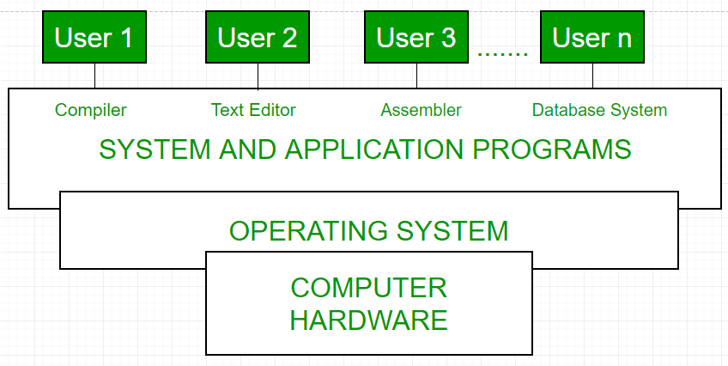
Computer System

Slide 16
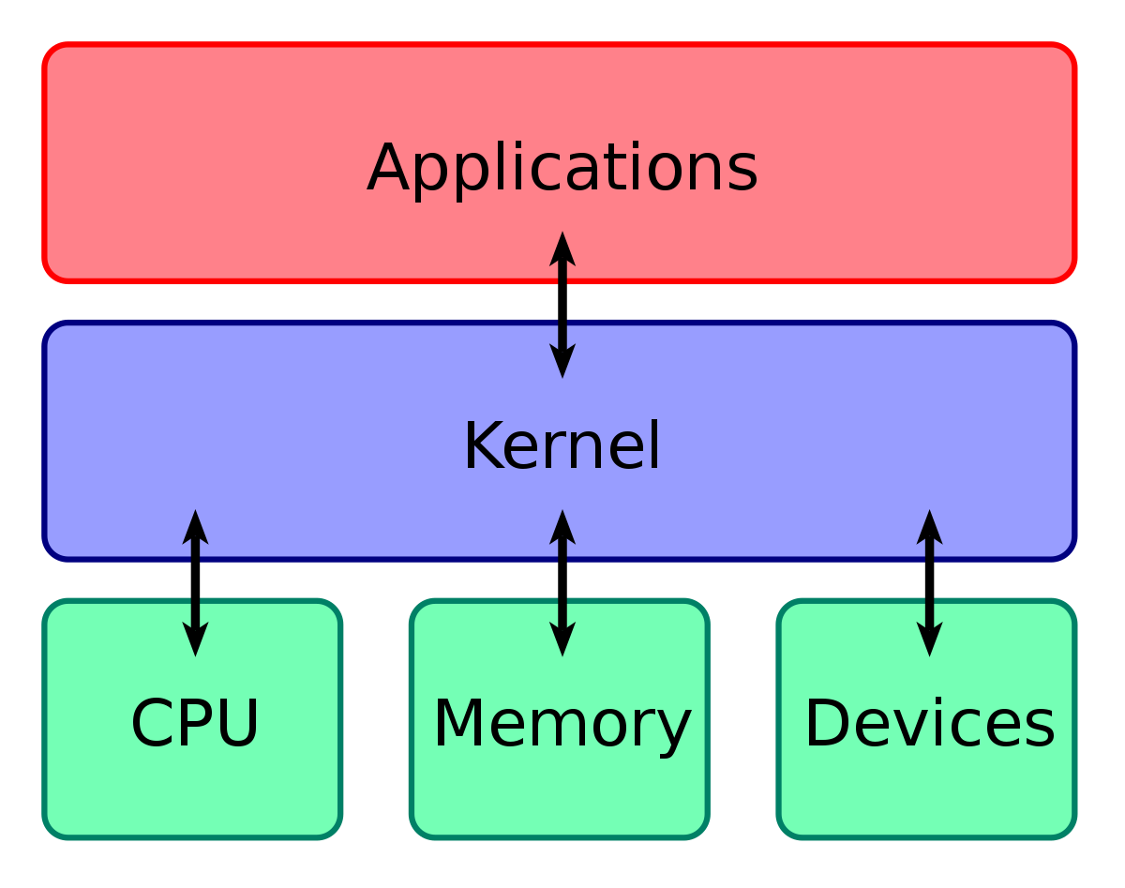
WHAT IS KERNAL?

Slide 17
WHAT IS KERNAL?
A kernel is the core component of an operating system. Using interprocess communication and system calls, it acts as a bridge between applications and the data processing performed at the hardware level. When an operating system is loaded into memory, the kernel loads first and remains in memory until the operating system is shut down again. The kernel is responsible for low-level tasks such as disk management, task management and memory management.

Slide 18
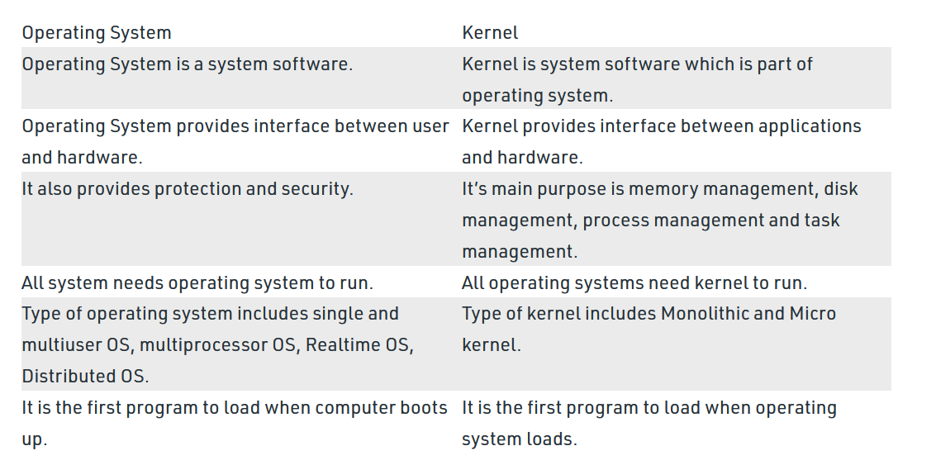

Slide 19
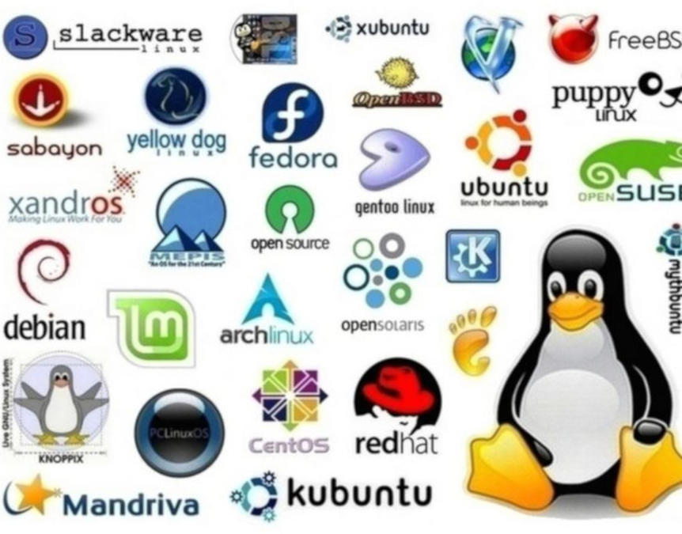
Linux

Slide 20

Overview
Initially created as a hobby by a young student, Linus Torvalds, at the University of Helsinki in Finland.
Linus had an interest in Minix, a small UNIX system, and decided to develop a system that exceeded the Minix standards.
He began his work in 1991 when he released version 0.02 and worked steadily until 1994 when version 1.0 of the Linux Kernel was released.
The kernel, at the heart of all Linux systems, is developed and released under the GNU General Public License (GNU's Not Unix!‘),
Linus Torvalds re-implemented a UNIX API (Application Programming Interface ) under the GPL license.

Slide 21
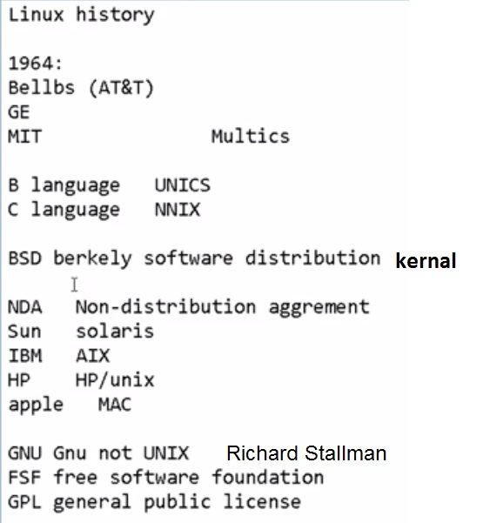

Discussion 1

Slide 22
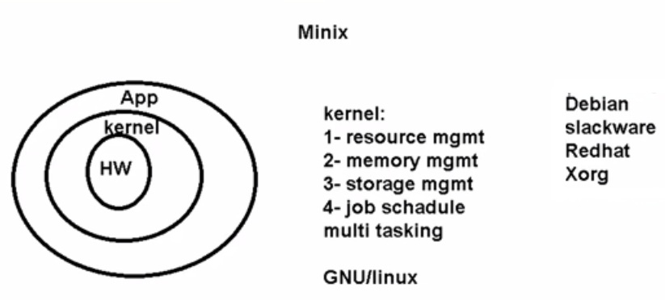
Discussion 2

Slide 23
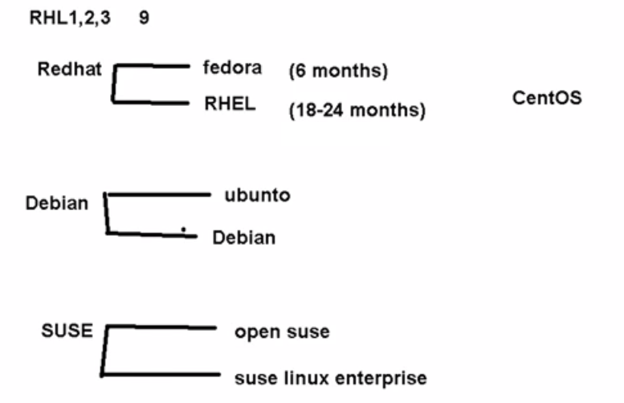
Discussion 3

Slide 24
Overview cont.
Popular Linux distributions include Debian, Fedora, and Ubuntu. Commercial distributions include Red Hat
Enterprise Linux and SUSE Linux Enterprise Server.
Desktop Linux distributions include a windowing system such as X11 or Wayland, and a desktop environment such as GNOME or KDE Plasma 5.
Distributions intended for servers may omit graphics altogether. Because Linux is freely redistributable, anyone may create a distribution for any purpose.

Slide 25
Common Linux Distributions
Debian is one of the oldest Linux distributions, dating back to 1993. It can be used as a desktop or server OS. While it is described by sources as user friendly, its installation and initial configuration require additional steps that might make it a little complex for an entry level user. It can downloaded from: https://www.debian.org/distrib/.
Ubuntu is the most popular and user friendly version of Linux, according to most sources. It is based on Debian. It is easier to install and configure than Debian, and can be downloaded here: https://www.ubuntu.com/download/desktop.
Linux Mint is another user friendly, lightweight distribution. Some sources say it responds much faster and makes less use of hardware resources as compared to Windows. It can be downloaded from: https://linuxmint.com/download.php.
Fedora is considered relatively easy to install and is based on the once popular but now discontinued Red Hat Linux distribution. Home, server, and cloud versions are offered. It can be downloaded from: https://getfedora.org.
A note about Red Hat: While it was discontinued in 2003, Red Hat Enterprise is still active and is commercially sold. Many distros are free.
Kali, as previously mentioned, is a distribution developed primarily for security and penetration testing. It can be downloaded from: https://www.kali.org/downloads/.
CentOS is another distribution based on the now discontinued Red Hat distro. Sources differ as to how easy it is to use and whether it is best suited for new users or for more experienced admin-type users. It can be download from: https://www.centos.org/download/.
openSUSE is offered in two sub-distributions: Leap and Tumbleweed. Sources say Leap is an easy and user friendly distro which makes a good starting point for users new to Linux. Tumbleweed, on the other hand, is better suited to developers. Both can be downloaded from: https://software.opensuse.org/.

Slide 26
Basic Features of Linux
Portable – Portability means softwares can works on different types of hardwares in same way.Linux kernel and application programs supports their installation on any kind of hardware platform.
Open Source – Linux source code is freely available and it is community based development project. Multiple teams works in collaboration to enhance the capability of Linux operating system and it is continuously evolving.
Multi-User – Linux is a multiuser system means multiple users can access system resources like memory/ ram/ application programs at same time.
Multiprogramming – Linux is a multiprogramming system means multiple applications can run at same time.
Hierarchical File System – Linux provides a standard file structure in which system files/ user files are arranged.
Shell – Linux provides a special interpreter program which can be used to execute commands of the operating system. It can be used to do various types of operations, call application programs etc.
Security – Linux provides user security using authentication features like password protection/ controlled access to specific files/ encryption of data.
Performance -- very fast

Slide 27
The four essential freedoms of linux
The freedom to run the program as you wish, for any purpose (freedom 0).
The freedom to study how the program works, and change it so it does your computing as you wish (freedom 1). Access to the source code is a precondition for this.
The freedom to redistribute copies so you can help others (freedom 2).
The freedom to distribute copies of your modified versions to others (freedom 3).
By doing this you can give the whole community a chance to benefit from your changes. Access to the source code is a precondition for this.

Slide 28
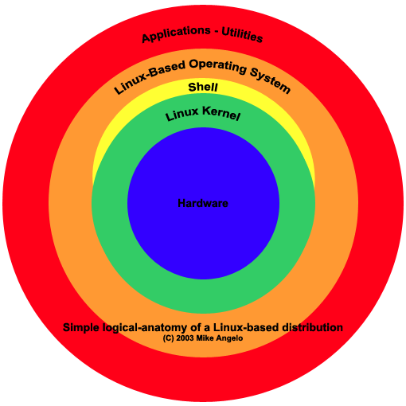

Slide 29
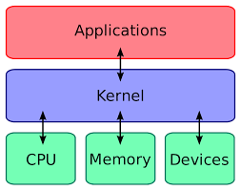
Linux kernel (1)

Slide 30
Linux kernal (2)
The operating system software file (program) which is copied into RAM, usually from the hard disk drive, during the boot-up.
The kernel remains in RAM while the computer is on and is in charge of the overall operation of the computer system.
The kernel contains the “internal programs” for the most often used operations like copying files.

Slide 31
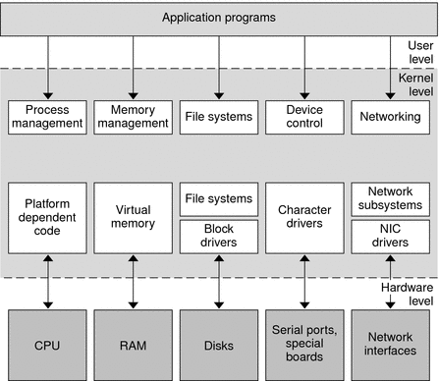

Slide 32
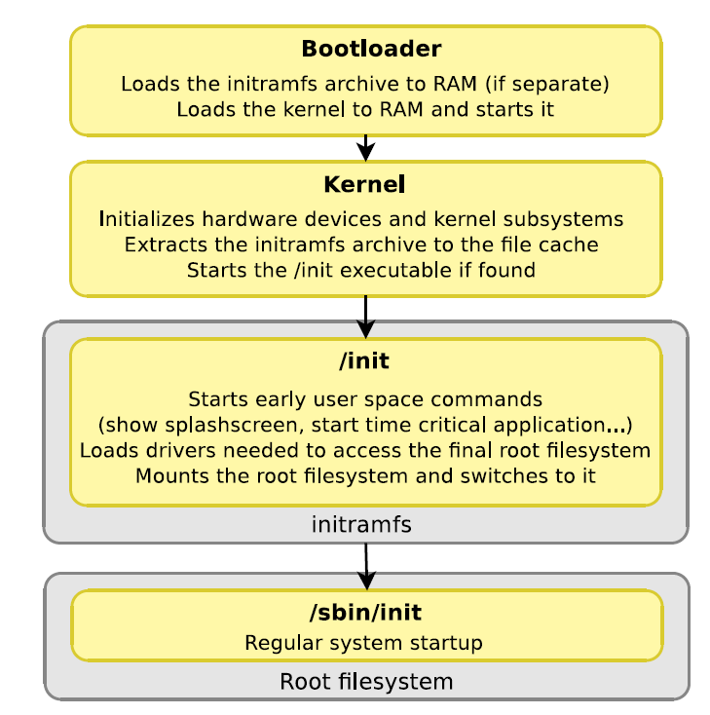
booting

Slide 33
Boot Loader
Booting is a process that starts operating systems when the user turns on a computer system.
A boot sequence is the initial set of operations that the computer performs when it is switched on.
The bootloader typically loads the main operating system for the computer.
The bootloader may be multistage
In Desktop Computers, the boot process involve running of system BIOS followed by the second stage bootloader like GRUB, BOOTMGR, LILO or NTLDR which is located in the boot sector of the boot device or the hard disk.

Slide 34
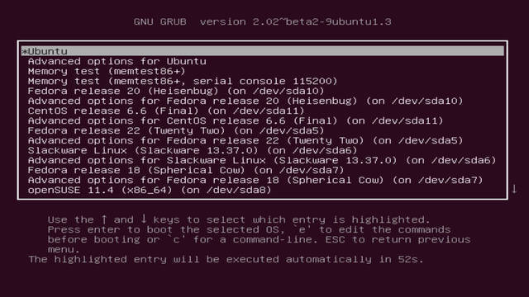
Grub 2

Slide 35
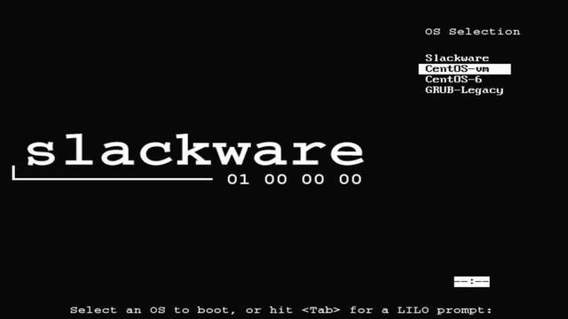
Lilo

Slide 36
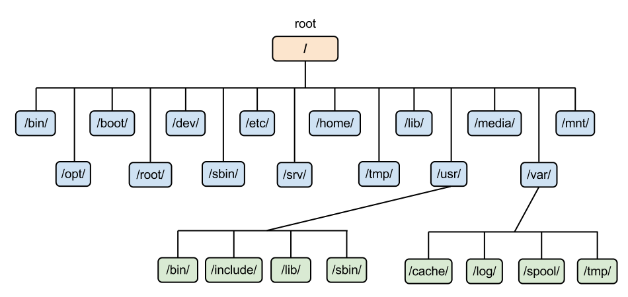
HIERARCHICAL FILESYSTEM

Slide 37
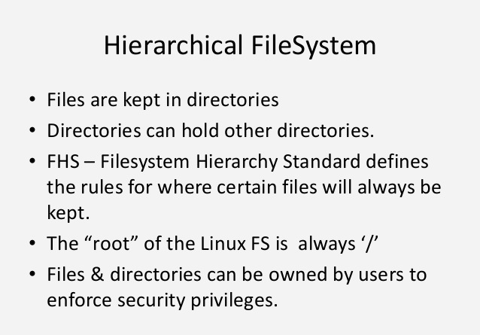

Slide 38
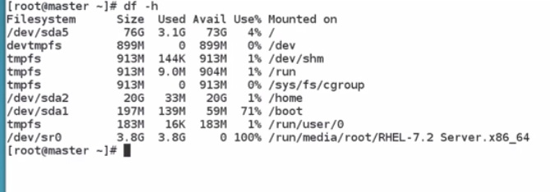
Partitions

Slide 39
Linux file system types
(ext2, ext3 and ext4)
XFS, JFS, and btrfs
a flash translation layer(FTL)
Memory Technology Device (MTD)
UBIFS, JFFS2 and YAFFS
SquashFS is a common compressed read-only file system.

Slide 40
Ext4(extended file system) Features
Large file system The ext4 filesystem can support volumes with sizes up to 1 (EB) and single files with sizes up to 16 (TB) with the standard 4 KB block size.
The maximum file, directory, and filesystem size limits grow at least proportionately with the filesystem block size up to the maximum 64 KB block size .
Extents replace the traditional block mapping scheme used by ext2 and ext3. An extent is a range of contiguous physical blocks, improving large file performance and reducing fragmentation. A single extent in ext4 can map up to 128 MB of contiguous space with a 4 KB block size. There can be four extents stored directly in the inode. When there are more than four extents to a file, the rest of the extents are indexed in a tree.

Slide 41
Ext4(extended file system) Features cont.
Backward compatibility
Persistent pre-allocation
Delayed allocation
Unlimited number of subdirectories(In Linux 4.12 and later the largedir feature enabled a 3-level HTree and directory sizes over 2 GB, allowing approximately 6 billion entries in a single directory.)
Journal checksumming
Metadata checksumming
Faster file system checking
Multiblock allocator
Improved timestamps (nano seconds)
Project Quotas (The project ID of a file is a 32-bit number stored on each file, and is inherited by all files and subdirectories created beneath a parent directory with an assigned project ID)
Transparent encryption

Slide 42
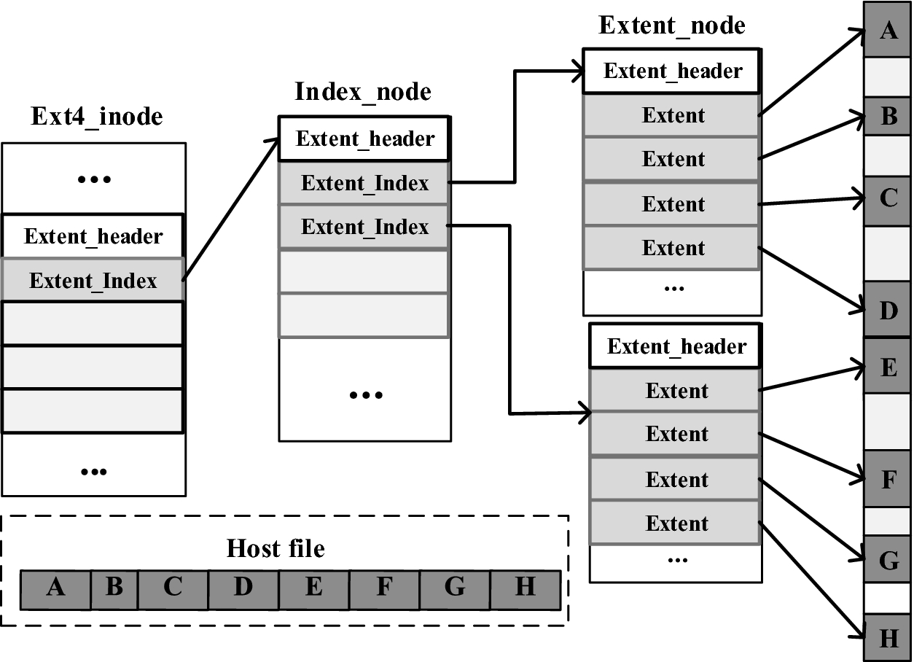

Slide 43
Allocate-on-flush
(also called delayed allocation) is a file system feature implemented in HFS+, XFS, Reiser4, ZFS, Btrfs, and ext4. The feature also closely resembles an older technique that Berkeley's UFS called "block reallocation".
When blocks must be allocated to hold pending writes, disk space for the appended data is subtracted from the free-space counter, but not actually allocated in the free-space bitmap. Instead, the appended data are held in memory until they must be flushed to storage due to memory pressure, when the kernel decides to flush dirty buffers, or when the application performs the Unix "sync" system call.

Slide 44
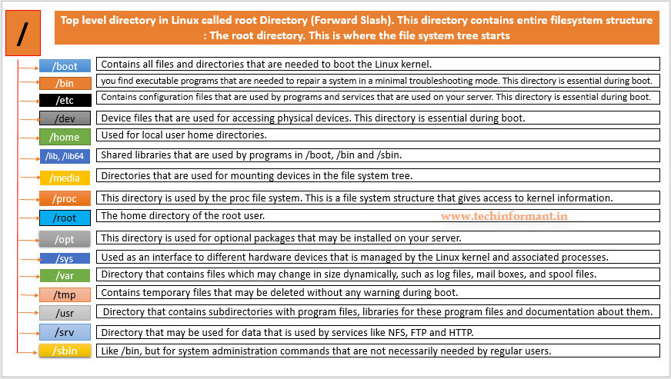
Linux File System

Slide 45
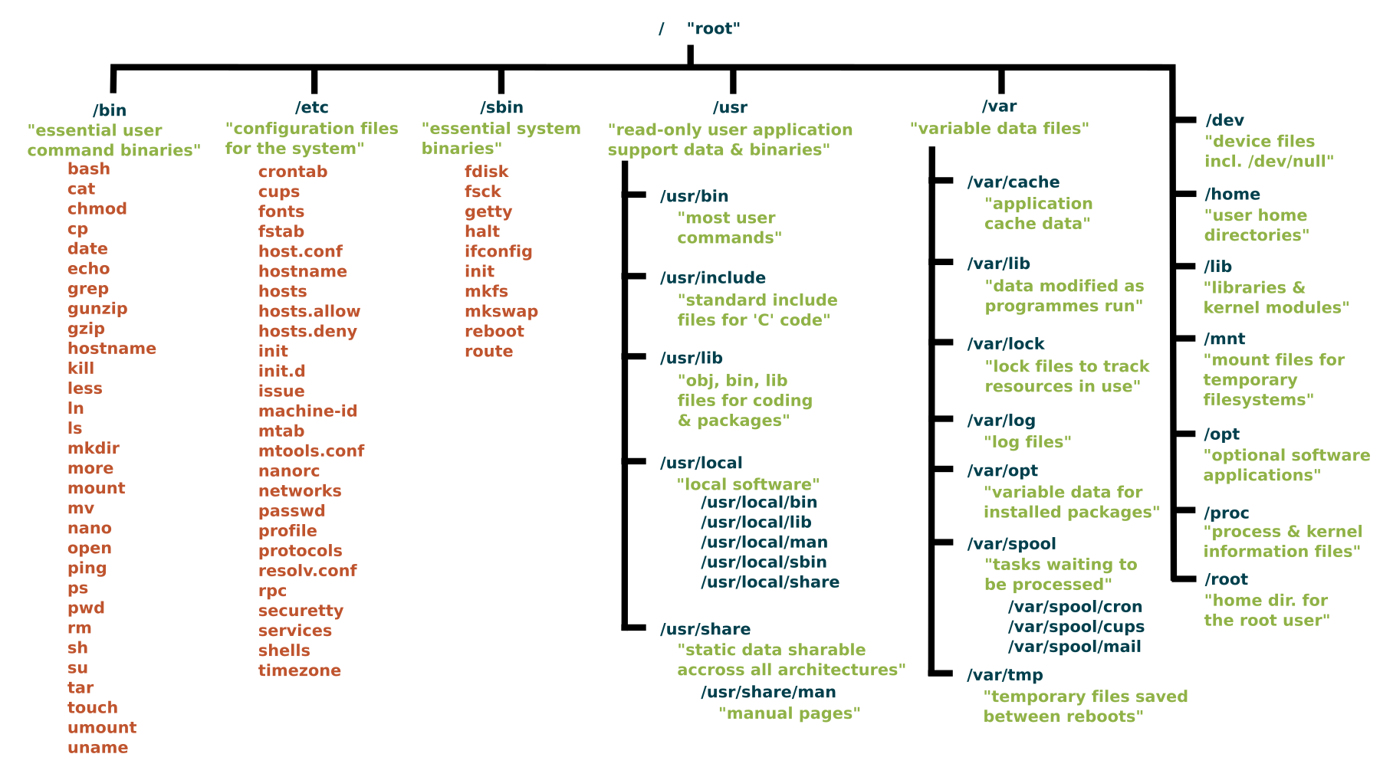
Linux File System(cont.)

Slide 46
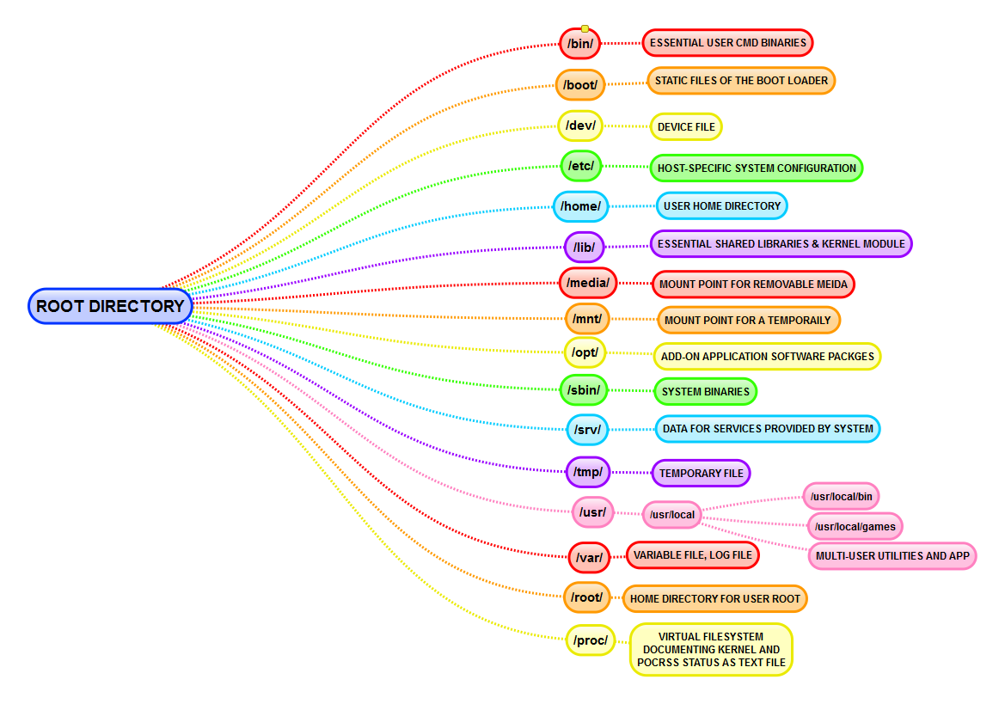

Slide 47
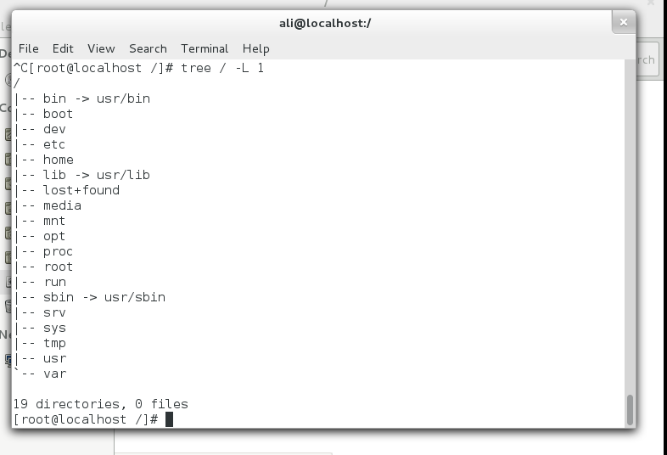
Linux File System Example

Slide 48
root Definition
root is the user name or account that by default has access to all commands and files on a Linux or other Unix-like operating system. It is also referred to as the root account, root user and the superuser.
One of these is the root directory, which is the top level directory on a system. That is, it is the directory in which all other directories, including their subdirectories, and files reside. The root directory is designated by a forward slash ( / ).
Another is /root (pronounced slash root), which is the root user's home directory. A home directory is the primary repository of a user's files, including that user's configuration files, and it is usually the directory in which a user finds itself when it logs into a system.

